Slide 1
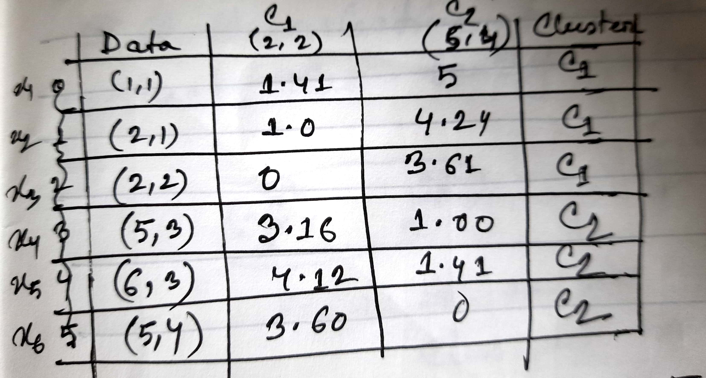
K-Means (1)
K-Clustering

Slide 2
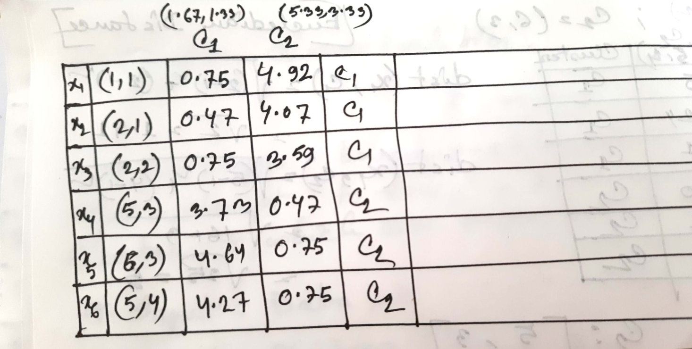
K-Means (2)

Slide 3
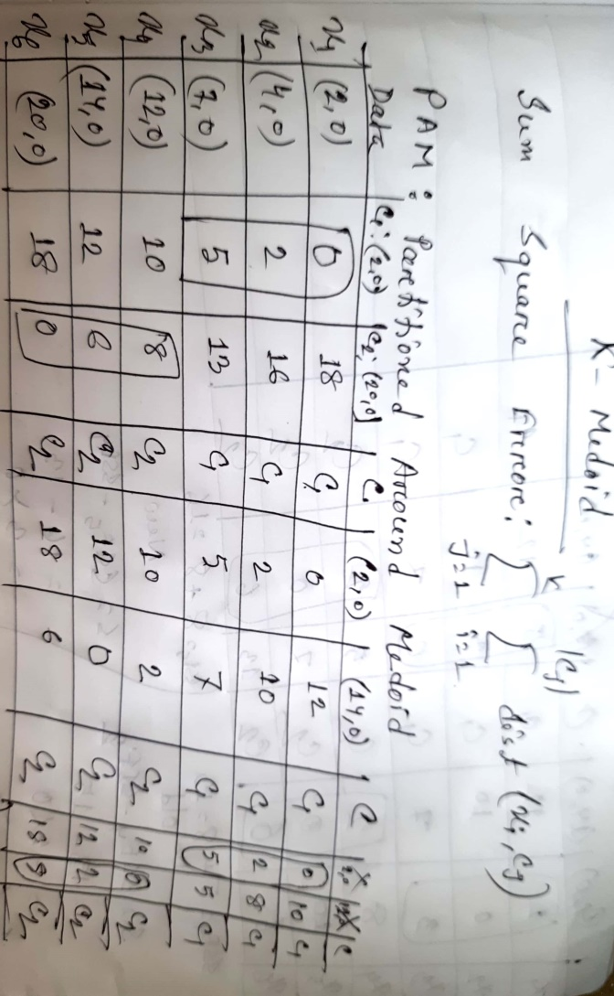
K-Medoid (1)

Slide 4
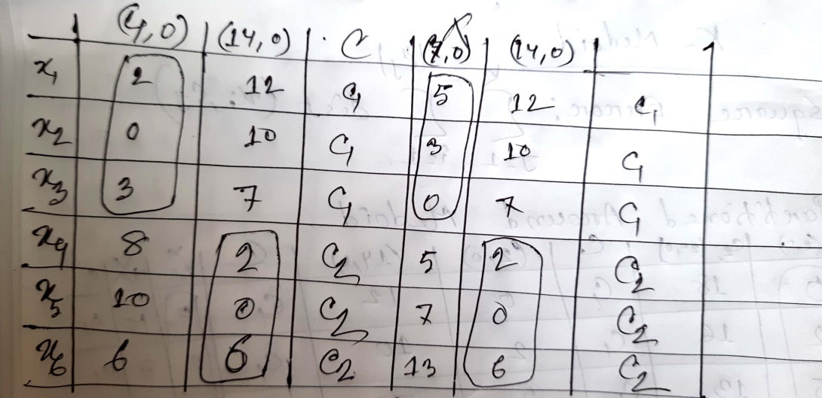
K-Medoid (2)

Slide 5
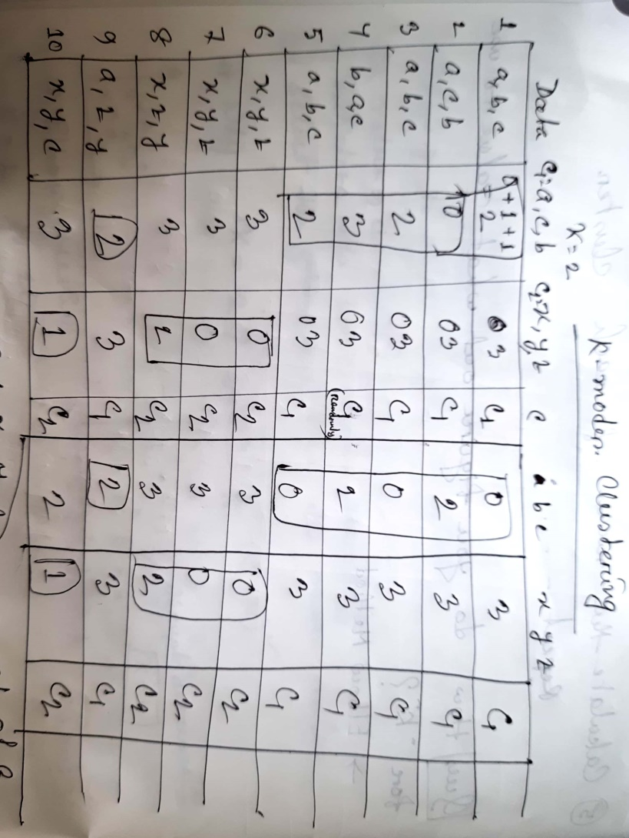
K-Modes

Slide 6
The End

